Slide 1
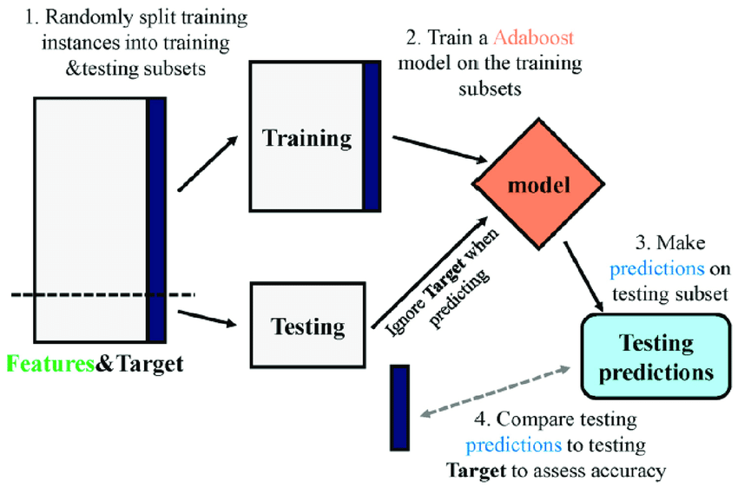
BOOSTING ALGORITHM-REGRESSOR
ADA BOOST:
An AdaBoost regressor is a meta-estimator used in machine learning for regression problems. It is a type of ensemble learning that begins by fitting a regressor on the original dataset and then fits additional copies of the regressor on the same dataset but where the weights of instances are adjusted according to the error of the current prediction
How AdaBoost Works
The principle behind AdaBoost is to iteratively train weak classifiers on the training dataset, with each successive classifier giving more weight to the data points that are misclassified. The final AdaBoost model is a combination of all the weak classifiers, weighted according to their accuracies

Slide 2
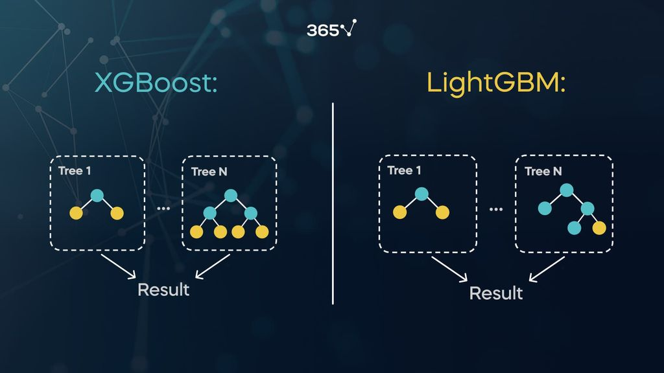
XG BOOSTING:
XGBoost is a powerful approach for building supervised regression models. The validity of this statement can be inferred by knowing about its (XGBoost) objective function and base learners. The objective function contains loss function and a regularization term. It tells about the difference between actual values and predicted values, i.e how far the model results are from the real values.
LG BOOSTING:
LightGBM is an open-source gradient boosting framework that based on tree learning algorithm and designed to process data faster and provide better accuracy. It can handle large datasets with lower memory usage and supports distributed learning.

